Slide 1
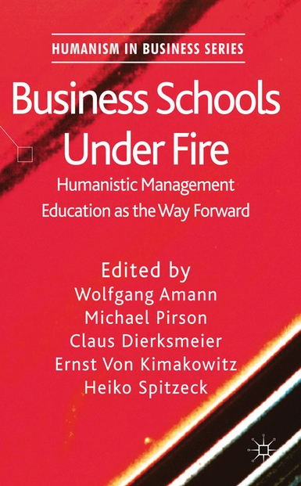
Business Schools Under Fire
Edited by: W. Amann, M. Pirson, C. Dierksmeier, E. v. Kimakowitz & H. Spitzeck
A Palgrave Macmillan Publication from the Humanism in Business Series. In a time of ecological, social and financial crisis, trust in managers is very low. Management education in general is being scrutinized for its impact on society and business schools have been described as 'silent partners in corporate crime.‘
Business Schools Under Fire provides thought provoking input towards rethinking management education.
Full Citation: Busines Schools Under Fire, Amann, W., Pirson, M., Dierksmeier, C., von Kimakowitz, E., Spitzeck, H. (Eds.) (2011). Houndmills: Palgrave Macmillan

