Slide 1
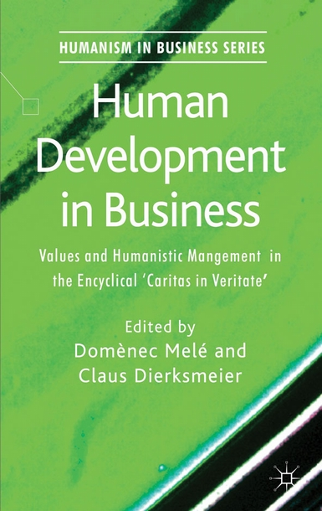
Human Development in Business
Edited by: D. Melé and C. Dierksmeier
A Palgrave Macmillan Publication from the Humanism in Business Series. A significant voice in encouraging theoretical development and practical implementation of humanistic management is Pope Benedict XVI. In his Encyclical Letter Caritas in Veritate published in 2009, he proposed a new humanistic synthesis to realign the economy with its social purpose.
Human Development in Business is an interdisciplinary dialogue on its relevance for humanistic management.
Full Citation: Human Development in Business, Melé, D. and Dierksmeier, (Eds.) (2012). Houndmills: Palgrave Macmillan

