Slide 1
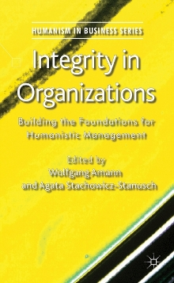
Integrity in Organizations
Edited by: W. Amann & A. Stachowicz-Stanusch
A Palgrave Macmillan Publication from the Humanism in Business Series.
Integrity in Organizations moves beyond the normative call for more humanistic management in the aftermath of a series of corporate scandals, recent financial crisis as well as increasingly questioned blind fellowship of one-dimensional profit maximization as the sole compass for companies. It sheds light on how we can actually build more humanistic organizations with the help of integrity.
Full Citation: Integrity in Organizations, Amann, W. & Stachowicz-Stanusch, A. (Eds.) (2011). Houndmills: Palgrave Macmillan

